Slide 1
18 Example of SIP
Solo Iteration Process(SIP)
Software begins by a very simple initial development
Functionality is added one step at a time by software changes (SC)
  initial development + 11 SC’s
© 2012 by Václav Rajlich

Slide 2
Point of Sale
Keeps inventory
Keeps records of cashiers
Allows sale of items at terminal
Records store cash balance
Keep track of fluctuating regular prices and sale prices
© 2012 by Václav Rajlich

Slide 3
Sequence of tasks
Initial version: single item sold, only cash payment, single price, etc.
Expand inventory to support multiple items.
Support multiple prices with effective dates.
Implement promotional prices.
Support the log-in of a single cashier.
Support multiple cashiers.
Add cashier session.
© 2012 by Václav Rajlich

Slide 4
Sequence of tasks (cont.)
Keep detailed sale records such as item sold and date/time of sale.
Support multiple items per transaction.
Expand concept of cash payment to include cash tendered, change, and keep track of these values with regards to a specific sale.
Implement credit card payment.
Implement check payment.
© 2012 by Václav Rajlich

Slide 5
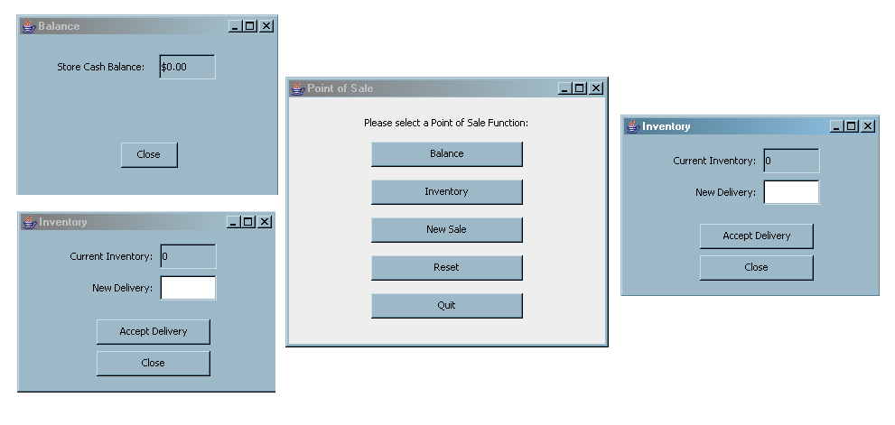
1. Initial version (one class)
© 2012 by Václav Rajlich

Slide 6
Task 1. Expand inventory
Concept location, impact analysis
  trivial
Prefactoring
  two extractions
    class Inventory
    class Item
© 2012 by Václav Rajlich

Slide 7

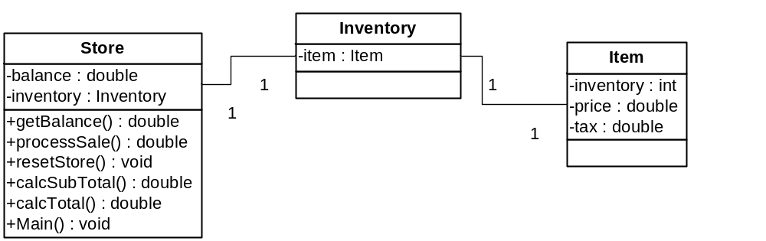
After prefactoring
© 2012 by Václav Rajlich

Slide 8
Completing SC
Actualization
  new fields in the Item class
    UPC, item name, current quantity
  class Inventory
    a new data structure to hold a collection of items
Change Propagation
  field Item is removed
© 2012 by Václav Rajlich

Slide 9
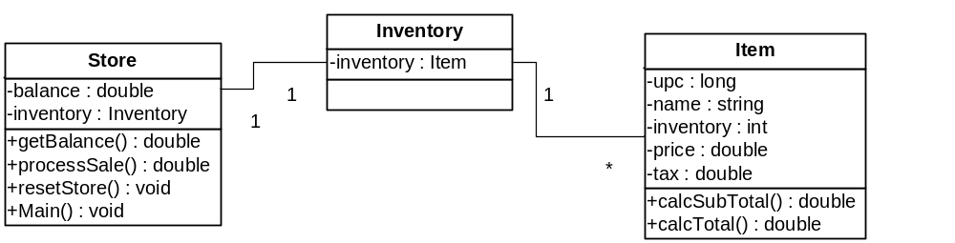
Class diagram after Task 1
© 2012 by Václav Rajlich

Slide 10
Task 7: Add cashier session
Explicit concept: “Session”
Each login will start a new session
Session data
  login/logout times
  number of transactions
  cash totals
© 2012 by Václav Rajlich

Slide 11
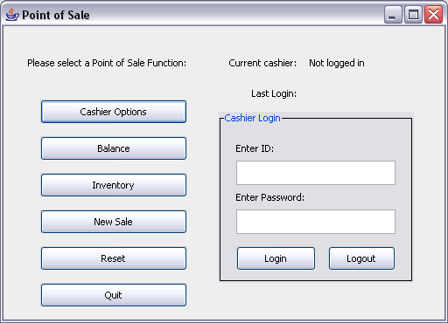
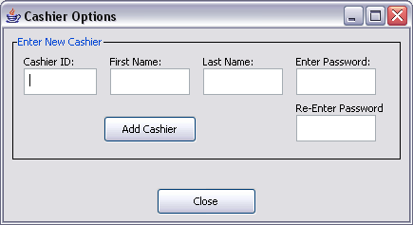
Before SC
© 2012 by Václav Rajlich

Slide 12
Concept location
Static dependency search begins at class containing main()
Cashier
Store
Not found
main()
CashierRecord
Inventory
Item
Found
Not found
Price
PromoPrice
© 2012 by Václav Rajlich

Slide 13
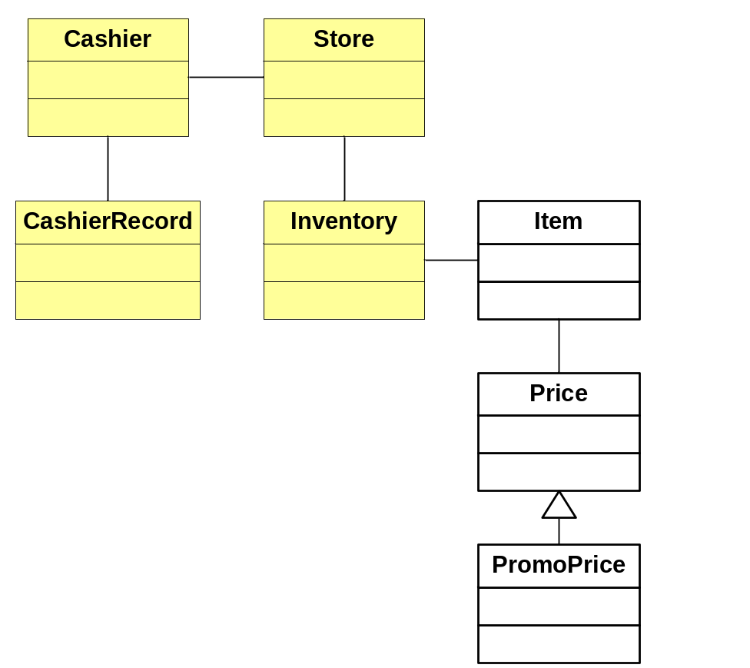
Impact analysis
Highlighted classes represent the impact set
© 2012 by Václav Rajlich

Slide 14
Prefactoring
Extract class Session from CashierRecord
Cashier
Store
CashierRecord
Inventory
Item
Session
Price
PromoPrice
© 2012 by Václav Rajlich

Slide 15
Actualization
Add new fields
  logout time
  total cash
  total number of transactions
Create methods to increment cash and transaction totals
© 2012 by Václav Rajlich

Slide 16
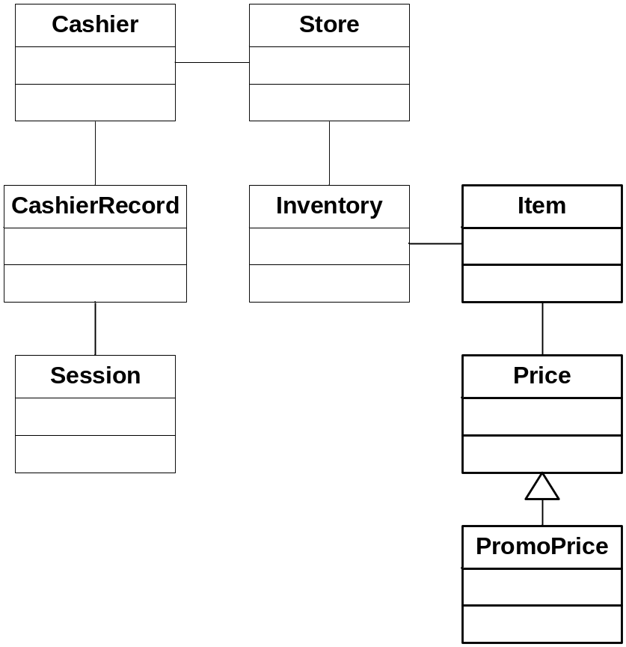
Change Propagation
CashierRecord
  Changed to keep collection of sessions
Cashier
  Supporting methods were added
Store
  commitSale() method changed to update current session data
Inventory
  Visited, not changed
STOP
© 2012 by Václav Rajlich

Slide 17
Testing
7 test classes before SC
  55 assertions
8 test classes after SC
  1 new test class to test Session (SessionTest)
  relevant test methods moved from CashierRecordTest to SessionTest
  65 total assertions after SC
© 2012 by Václav Rajlich

Slide 18
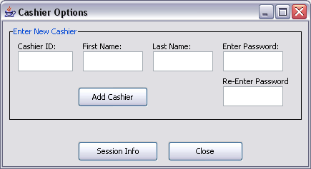
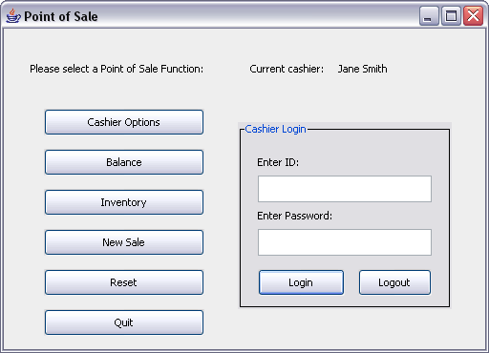
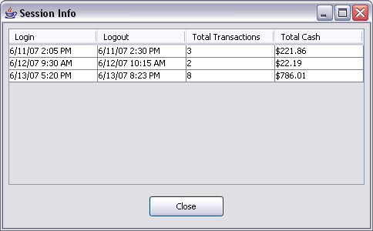
After SC
© 2012 by Václav Rajlich

Slide 19
Task 9: Multiple Items per Sale
System currently only supports one item type per sale.
This SC expands on the sale concept to include multiple line items for a sale.
© 2012 by Václav Rajlich

Slide 20
Concept Location
Examine class dependencies, starting with Main() method in the Store class
  located in Sale class, as the saleItem field.
    explicit concept
    we will expand the primitive concept
© 2012 by Václav Rajlich

Slide 21
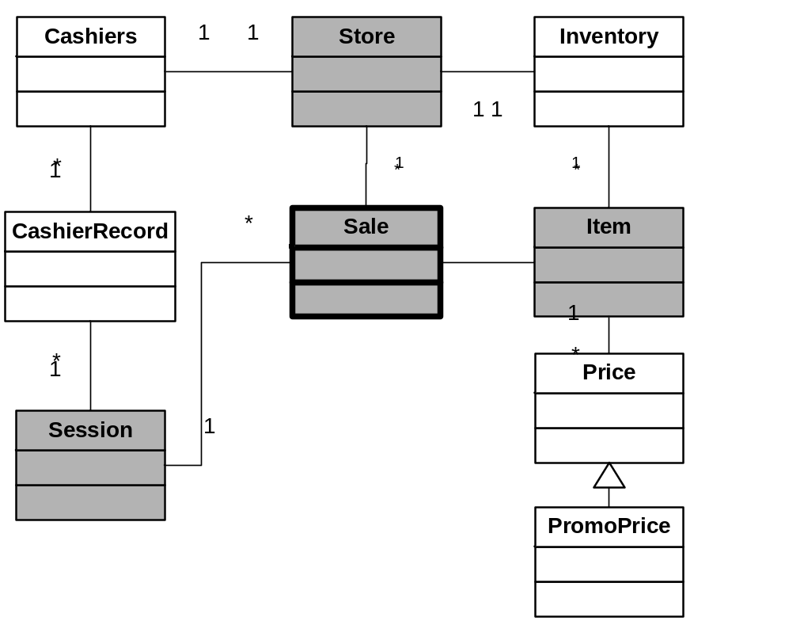
Impact Analysis
Shaded classes are in the impact set
© 2012 by Václav Rajlich

Slide 22
Prefactoring
SaleLineItem class is extracted from the Sale class
SaleLineItem
© 2012 by Václav Rajlich

Slide 23
Actualization
SaleLineItem instance in the Sale class is changed to a collection of line items.
quantity field added to SaleLineItem.
Supporting methods added to the SaleLineItem class.
© 2012 by Václav Rajlich

Slide 24
Change propagation
Sale class
  SaleLineItem instance changed to a collection of objects.
  support methods added.
Store class
  processSale method changed to remove inventory for all line items.
© 2012 by Václav Rajlich

Slide 25
Case study data
Phase | Total Classes
 | Before | New | Changed (propagation) |  | After
1: initial | 0 | 1 | 0 |  | 1
2: inventory | 1 | 2 | 1 |  | 3
3: multiple prices | 3 | 1 | 3 |  | 4
4: promo prices | 4 | 1 | 3 |  | 5
5: cashier login | 5 | 2 | 1 |  | 7
6: multiple cashiers | 7 | 1 | 2 |  | 8
7: cashier sessions | 8 | 1 | 4 |  | 9
8: detailed sale | 9 | 1 | 4 |  | 10
9: multiple line items | 10 | 1 | 2 |  | 11
10: payment | 11 | 1 | 1 |  | 12
11: credit payment | 12 | 2 | 2 |  | 14
12: check payment | 14 | 1 | 1 |  | 15
© 2012 by Václav Rajlich

Slide 26
Case study data
Phase | Explicit / Implicit Concept | Prefactoring | Postfactoring
1: initial | N/A | N/A | N/A
2: inventory | explicit | extract class | extract method move method
3: multiple prices | explicit | extract class | none
4: promo prices | implicit | none | extract method
5: cashier login | implicit | none | none
6: multiple cashiers | explicit | extract class | extract method rename class
7: cashier sessions | explicit | extract class | none
8: detailed sale | explicit | extract class | none
9: multiple line items | explicit | extract class | none
10: payment | implicit | none | none
11: credit payment | implicit | extract superclass | none
12: check payment | implicit | none | none
© 2012 by Václav Rajlich

Slide 27
Case study testing overview
Step | Test Classes | Assertions
1 | 1 | 12
2 | 3 | 34
3 | 4 | 37
4 | 5 | 40
5 | 6 | 53
6 | 7 | 55
7 | 8 | 65
8 | 9 | 68
9 | 10 | 71
10 | 11 | 77
11 | 13 | 89
12 | 14 | 98
© 2012 by Václav Rajlich

Slide 28
Tool support
JUnit – unit testing framework for Java
Abbot – functional testing framework for graphical user interfaces
Refactoring browser
  built in refactorings in Eclipse
  we need more (extract class)
© 2012 by Václav Rajlich

Slide 29
Resulting architecture
Register
CashDrawer
Person
Session
Cashier
Store
Cashiers
Store
Inventory
TaxCategory
Sale
Item
CashierRecord
UPC
Sale
Item
SaleLineItem
Session
Price
Payment
ReturnLineItem
SaleLineItem
Price
PromoPrice
Payment
SIP
Cash
AuthorizedPayment
OOD
PromoPrice
Cash
Check
Charge
Check
Charge
© 2012 by Václav Rajlich

